Slide 1
Ceph Performance Evaluation and CBT
(Ceph Benchmarking Tool)
Lee Sanders
Performance Analyst and Master Inventor
IBM Hursley, UK ljsanders@uk.ibm.com

Slide 2
CBT – Ceph Benchmarking Tool
Available at: https://github.com/ceph/cbt
Intention is to have a standardized performance evaluation suite which generates deterministic results
Users create a YAML file defining the Ceph Configuration, Workload.
      Will automatically create the Ceph configuration for you, do IO then generate data.
      Uses PDSH to fan out FIO/Ceph commands to all Ceph nodes.
Based on FIO – Industry Standard IO Exercisor used by clients
Lets you create plug-in’s, eg. librbd plug in.
Pulls together all the data from all nodes. Uses collectl to fetch node specific statistics (eg.CPU)
Post processing tool – fio-plot-stats.py in tools/fio_visualize_data/
Crimson add on to pull out crimson stats
Goal of CBT is to have consistent and repeatable methodology to performance evaluation
A number of limitations with the tool which I’ll highlight on the next slides mostly to do with post processing.

Slide 3
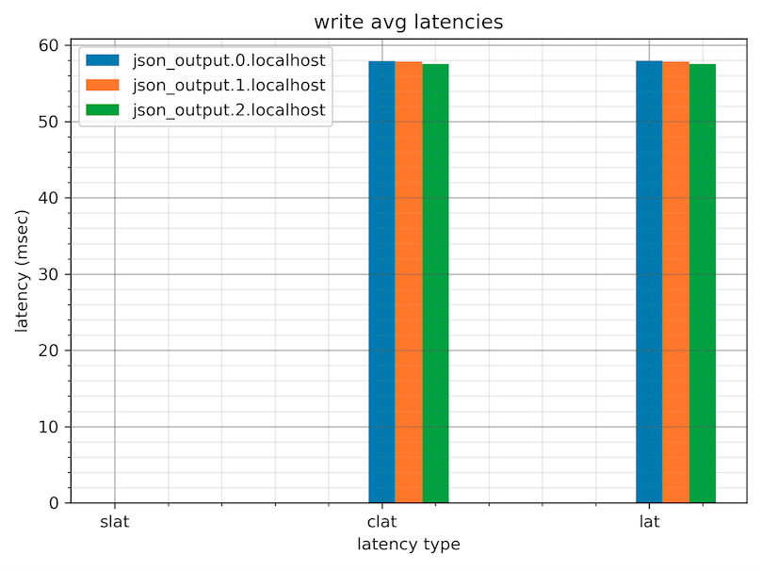
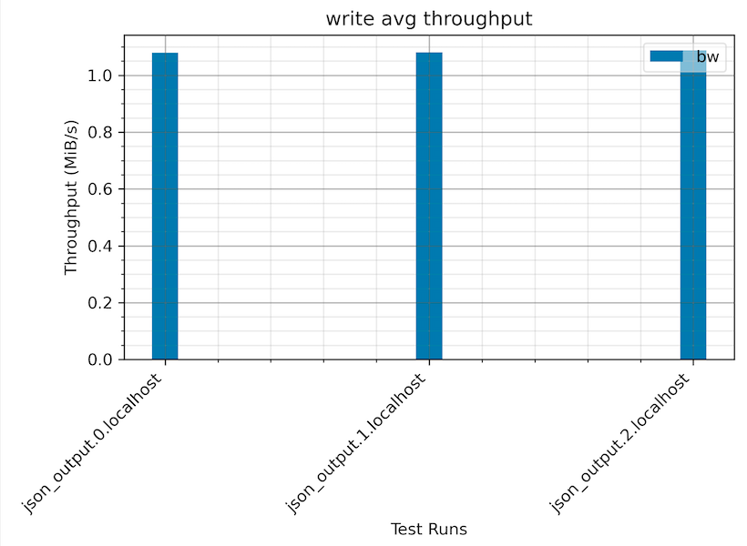
Current CBT Implementation
4k random writes – 3 RBD Images
FIO generates lots of files per volume.
Limited by post processing tool – in cbt/tools/fio_visualize_data/fio-plot-stats.py

Slide 4
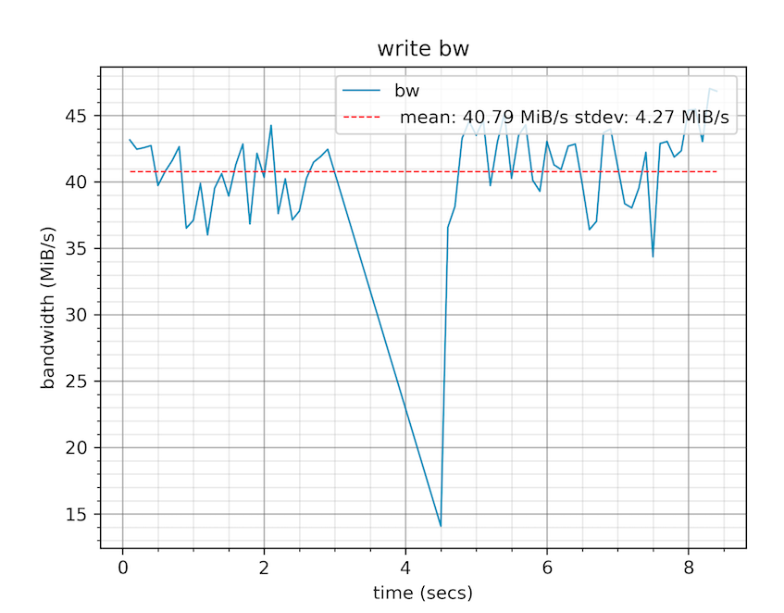
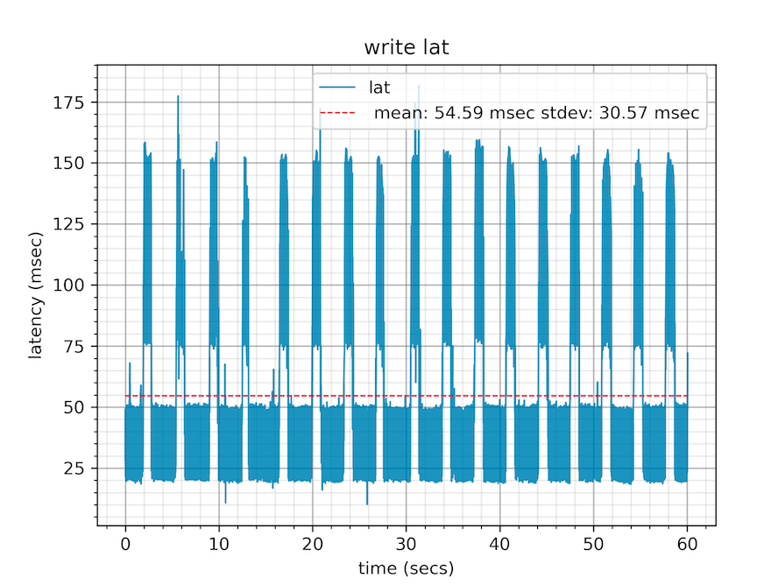
Current CBT Implementation
Issues:
You can view performance over time – but restricted to per volume. More interested in system totals
No IOPs graphs - Bandwidth = IOPS * IO size. Interested in IOPS if < 64k, Bandwidth for 32k+ IOs
Again – limitation of the post processing tool – fio_plot_stats.py

Slide 5
How to read response time curves
Each data point on the curve
Represents a set of measured data: it’s the average response time (latency) over at least a 3-minute period of data collection at a constant IO load.
Response times include the switch/network overheads, they are times seen by an application on a server.
All performance shown in this presentation represents steady-state, achievable and repeatable performance (not a “lab special” burst).
This point shows a host application will witness average IO response times of 400 microseconds when the throughput is
1 Million IO/sec
Important to put system into steady-state by pre-loading the system with data in a client like fashion. Typically randomized.

Slide 6
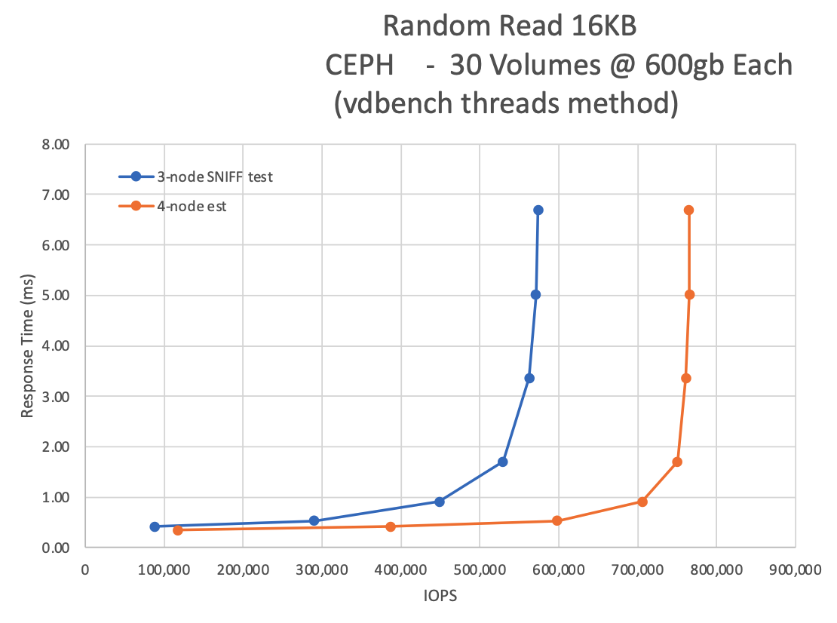
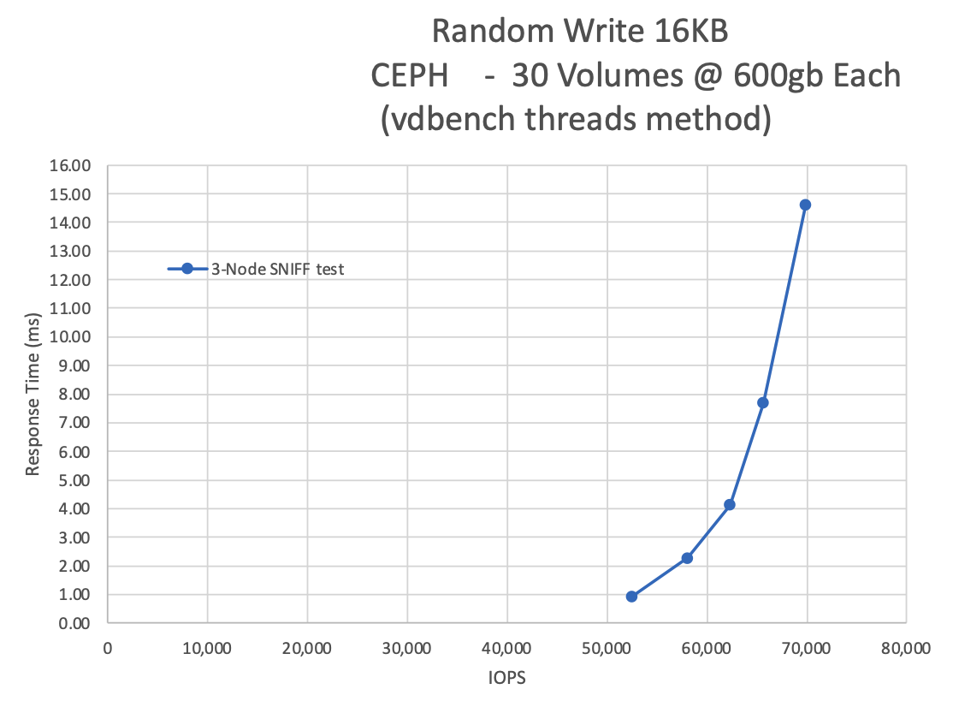
Performance Evaluation Basics
Not necessarily interested in MAX IOPS, Max bandwidth, unless you are interested in system limits - typically only useful for marketing type material.
Interested in total performance of all images being exercised.
More interesting to draw a curve of as throughput increases, how it affects latency
Most users operate no higher than around 70% of a curve.
Improving YAML format to allow better ordering of tests.

Slide 7
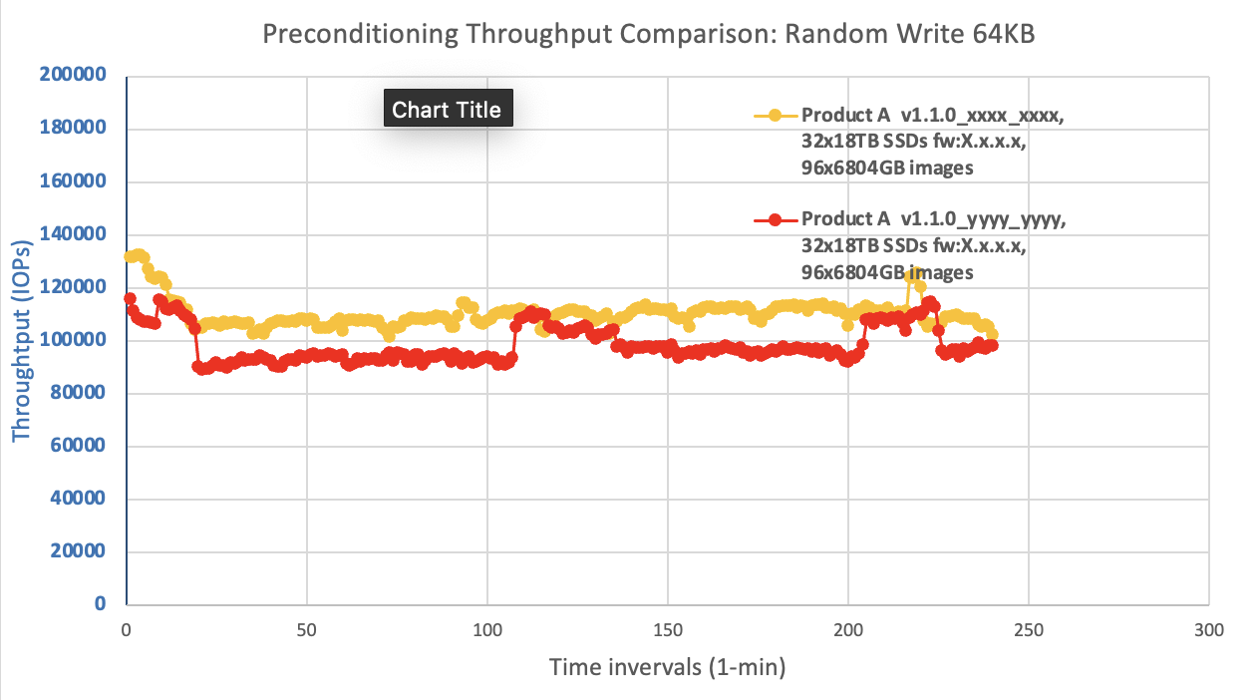
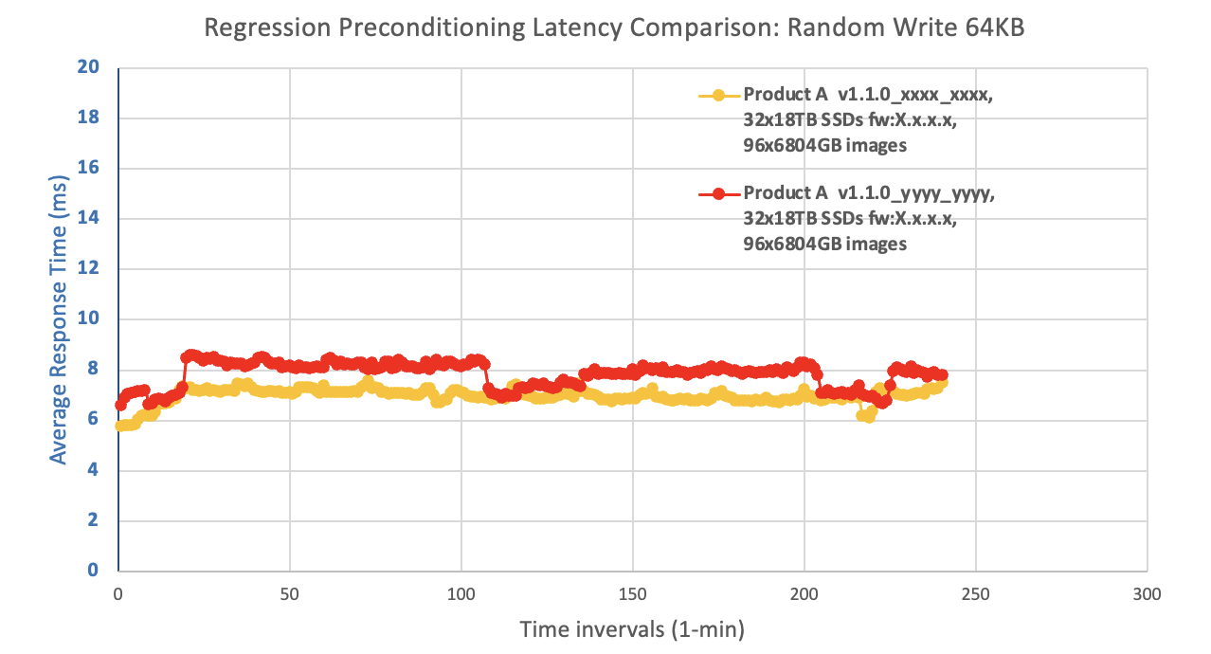
Performance Evaluation Basics
Interested in average vs maximum latency
Interested in the worst case latency – particularly during events
Users prefer consistent performance than spikey.
Note: Time interval on X-axis can mask latency.

Slide 8
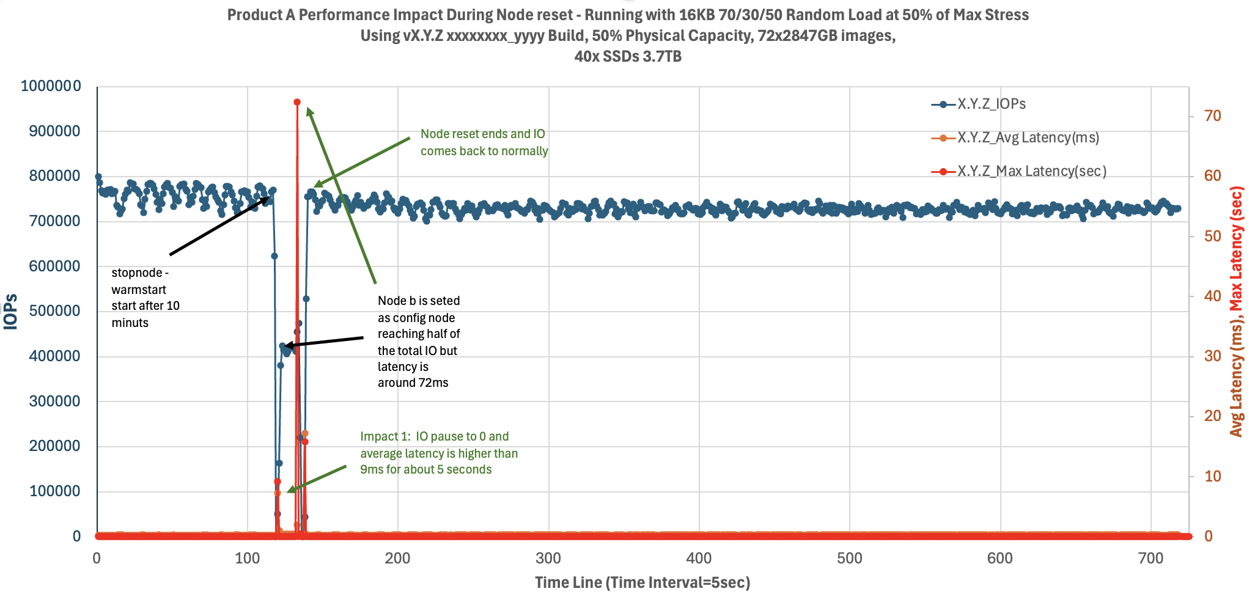
Performance Evaluation Basics
Interested in average vs maximum latency
Interested in the worst case latency – particularly during events
Users prefer consistent performance than spikey.
Note: Y-Axis range can mask latency variations/max

Slide 9
Performance Comparisons
Some variance is possible – 5 to 10% to be expected.
Performance is only comparable between systems if:
Consistent and Repeatable
Same number of nodes
Same CPU speed/cores, PCI Generation
Same number of OSDs
Same class of OSDs eg. TLC, QLC, MLC, SLC Flash, 7200/10k/15k RPM HDD
Same number of ports including speed of ports.
Same workload, read vs write, IO size, sequential vs random, overwrite vs miss
Same way the test was set up inc. prefill/preconditioning/fill capacity of storage
Same test order
Volume sizes/block working set size can have an impact: Small volumes/ranges can trigger overwrites vs misses.
Same environmental factors:
  Gotchas: backfill/garbage collection/peering in progress/initialization in progress

Slide 10
Vision for CBT
CBT needs updating for current generations of Ceph
Doesn’t support cephadm, in fact it doesn’t use vstart!
Want CBT to generate a standardized report:
Standardized Test Methodology that produces comparable results, with comparison tools
Simple to use for everybody
30+ Hockey stick curves with a defined test order, wide variety of customer like workloads with varying block sizes, sequential vs random, overwrite vs miss. Mixed (16k 70/30/50, 64k 70/30/50).
Regression test a build/fix in 12 to 14 hours.
Graphs with CPU utilization included with the throughput as an option to highlight where the bottlenecks could be.
Automatically collect configuration details and include in report.
Generate graphs with Histograms to show latency extremities (enabled via YAML).
Code profiling enablement for identifying code bottlenecks, flag via YAML.
Upload reports to a Github repo for everyone to see. (useful for customer sizings!).

Slide 11
Thank you for listening!
Come and see me if you have any questions and comments!
Lee Sanders
ljsanders@uk.ibm.com

