Slide 1
IBM Storage Ceph:
NVMe/TCP Gateway vSphere Integration

Slide 2
Why NVMe over TCP with VMware?
Ceph == Open Source software-defined storage, highly resilient, scalable, cost-effective
NVMe == density, performance, high-throughput (larger number of queues and queue paths, fewer clock cycles per I/O)
Ceph NVMe/TCP == unlocking the power of NVMe over modern high-bandwidth networks with disaggregated storage
IBM’s Storage Ceph VMware Plugin == brings Ceph storage workflows into the most popular L1 enterprise hypervisor

Slide 3


IBM Ceph NVMeoF Target Architecture
VSI
Hypervisor
NIC
Ceph Cluster
NVMe
NVMeoF
Initiator
VSI
NVMe
VSI
Hypervisor
SmartNIC
Ceph Node
OSD
Virtual Machines
NVMe
Rados Reactor
NVMeoF
Initiator
NVMeoF Target
VSI
NVMe/TCP
Protocol
Clustered
Failover
NVMe
Ceph Node
Rados Reactor
OSD
NVMeoF Target
NIC
NVMeoF
Initiator
Bare Metal
Ceph Node
OSD
Rados Reactor
NVMeoF Target
Bare Metal
SmartNIC
NVMe
NVMeoF
Initiator

Slide 4
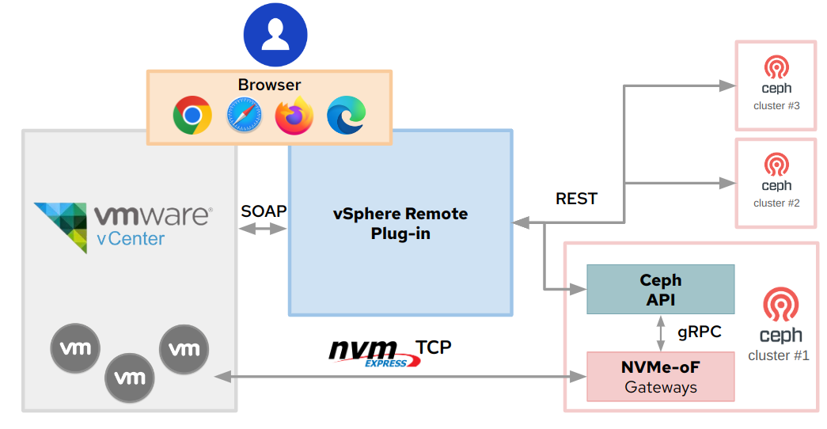
VMware vSphere Plugin Architecture
Notes:
IBM Storage Ceph releasing NVMe over TCP is an exciting new addition to Ceph’s already stellar history as the “Linux of Storage”
- Leverage existing and reliable components of current RADOS block devices (RBDs) and RBD Images
- Utilize the power of new NVMe drives for performance, flexibility, durability and scale
- Create net-new NVMe over TCP gateway to access these block devices over modern, cost-effective data center networks
- Utilizing SPDK (Storage Performance Development Kit, started: Intel, 2013) to enable connectivity to new, highly scalable, high performing workloads from user space

Slide 5
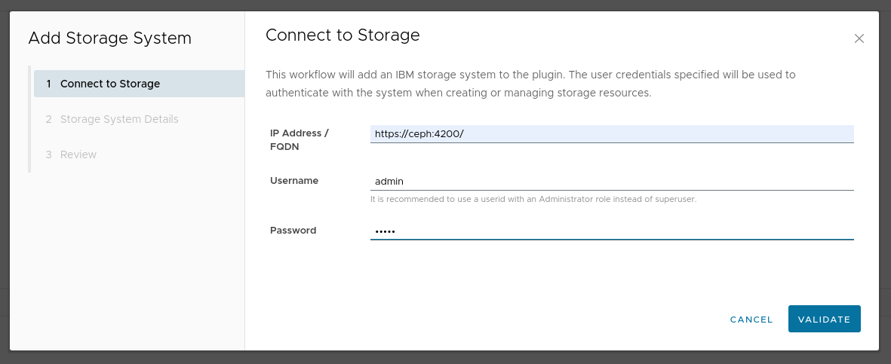
VMware vSphere Plugin add-cluster workflow
Notes:
IBM Storage Ceph releasing NVMe over TCP is an exciting new addition to Ceph’s already stellar history as the “Linux of Storage”
- Leverage existing and reliable components of current RADOS block devices (RBDs) and RBD Images
- Utilize the power of new NVMe drives for performance, flexibility, durability and scale
- Create net-new NVMe over TCP gateway to access these block devices over modern, cost-effective data center networks
- Utilizing SPDK (Storage Performance Development Kit, started: Intel, 2013) to enable connectivity to new, highly scalable, high performing workloads from user space

Slide 6
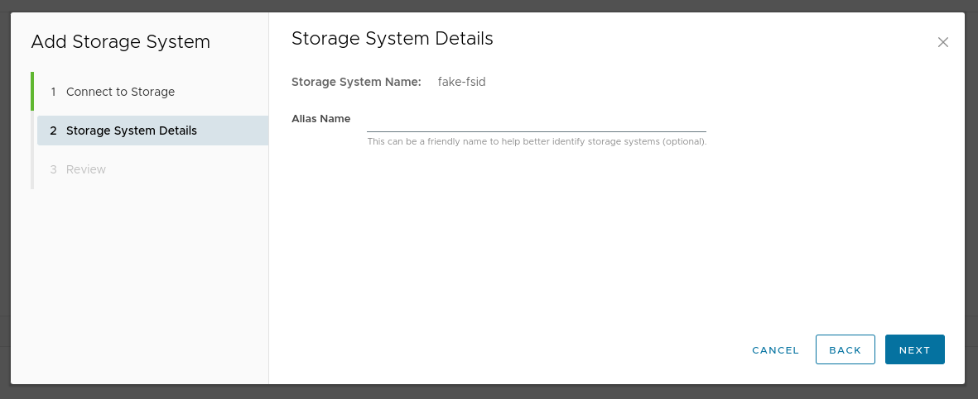
VMware vSphere Plugin add-cluster workflow
Notes:
IBM Storage Ceph releasing NVMe over TCP is an exciting new addition to Ceph’s already stellar history as the “Linux of Storage”
- Leverage existing and reliable components of current RADOS block devices (RBDs) and RBD Images
- Utilize the power of new NVMe drives for performance, flexibility, durability and scale
- Create net-new NVMe over TCP gateway to access these block devices over modern, cost-effective data center networks
- Utilizing SPDK (Storage Performance Development Kit, started: Intel, 2013) to enable connectivity to new, highly scalable, high performing workloads from user space

Slide 7
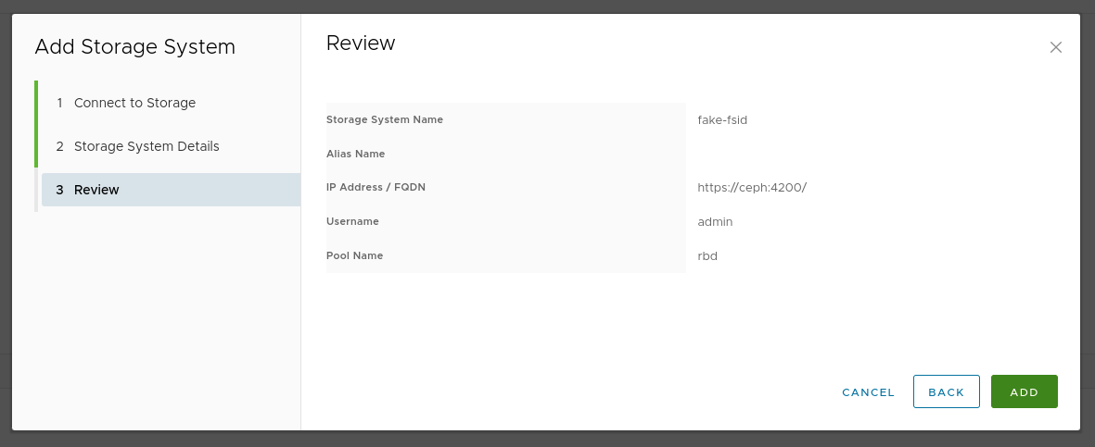
VMware vSphere Plugin add-cluster workflow
Notes:
IBM Storage Ceph releasing NVMe over TCP is an exciting new addition to Ceph’s already stellar history as the “Linux of Storage”
- Leverage existing and reliable components of current RADOS block devices (RBDs) and RBD Images
- Utilize the power of new NVMe drives for performance, flexibility, durability and scale
- Create net-new NVMe over TCP gateway to access these block devices over modern, cost-effective data center networks
- Utilizing SPDK (Storage Performance Development Kit, started: Intel, 2013) to enable connectivity to new, highly scalable, high performing workloads from user space

Slide 8
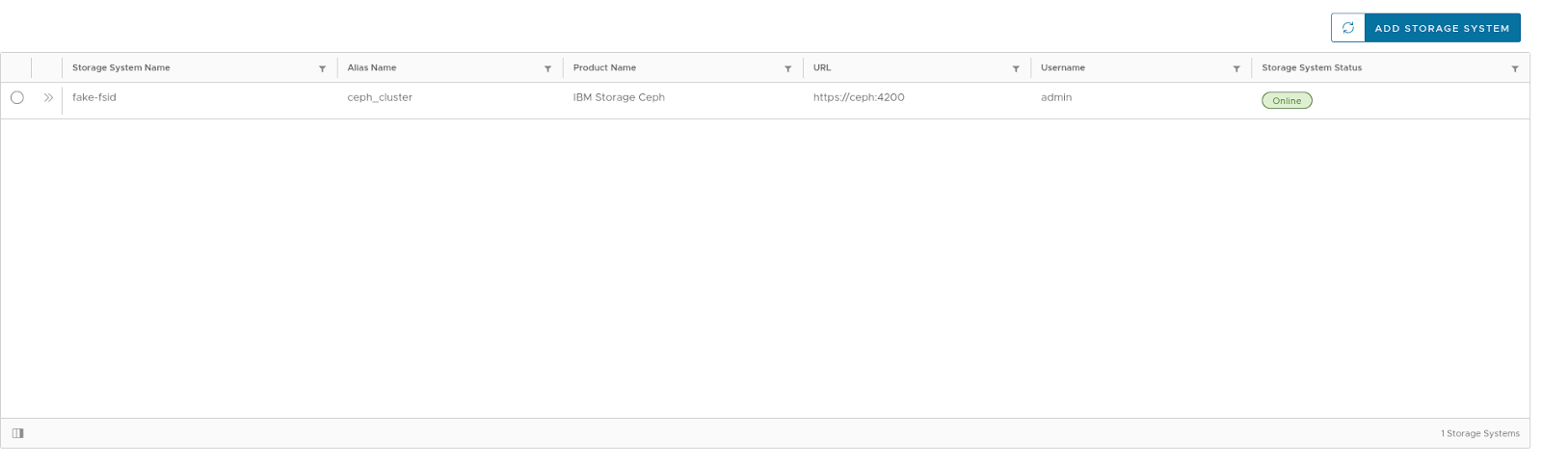
VMware vSphere Plugin add-cluster workflow
Notes:
IBM Storage Ceph releasing NVMe over TCP is an exciting new addition to Ceph’s already stellar history as the “Linux of Storage”
- Leverage existing and reliable components of current RADOS block devices (RBDs) and RBD Images
- Utilize the power of new NVMe drives for performance, flexibility, durability and scale
- Create net-new NVMe over TCP gateway to access these block devices over modern, cost-effective data center networks
- Utilizing SPDK (Storage Performance Development Kit, started: Intel, 2013) to enable connectivity to new, highly scalable, high performing workloads from user space

Slide 9
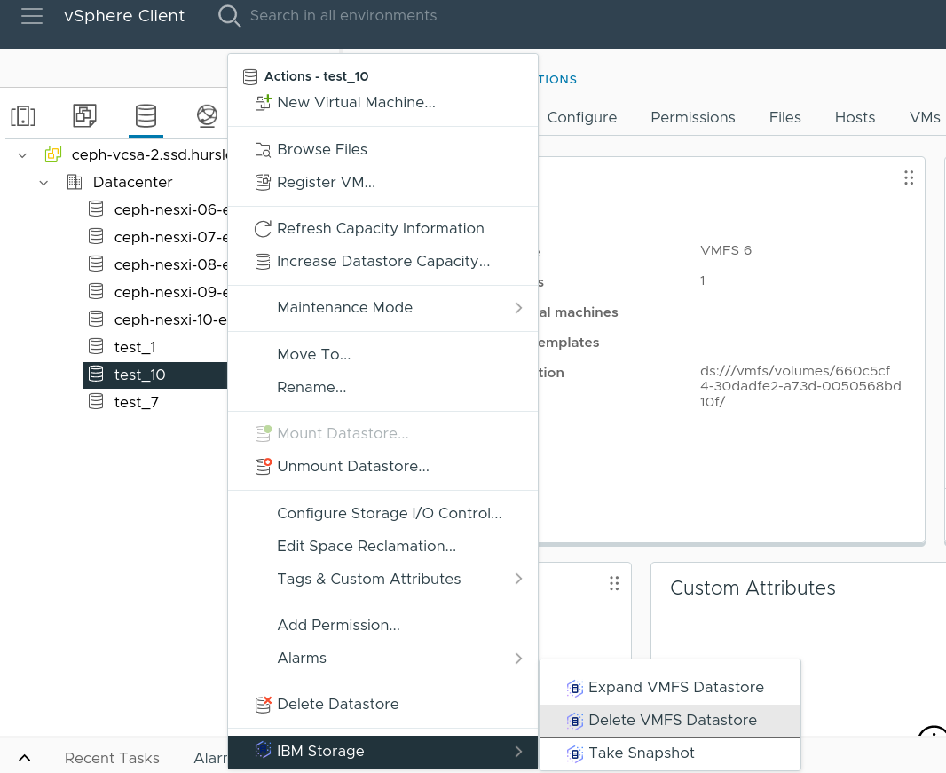
IBM Storage Ceph vSphere Plugin menu

Slide 10

IBM Storage Ceph Support for VMware
Ceph 7.1
vSphere Support – GA
Ceph 8.0
vSphere Support (2nd Phase)
Ceph 8.x+
  vSphere initiator for NVMeoF gateway solution (GA)
  VAAI Data Path Support
  VMware Snapshots/Clones support
  vMotion / storage vMotion support
  vSphere Certification (VIVa)
  vCenter management of Ceph with vSphere remote plug-in
  Capacity, health and performance
  monitoring via vCenter
  vCenter Plugin Enhancements
  Data Protection Certification (Backup Partners)
  VASA / Storage DRS and Tiering
  4 GW Groups, 16 GWs
  128 subsystems
  1024 namespaces
  VVols Support
  Site Recovery Manager (SRM) with SRA and native replication
  vCloud Director virtual object storage
  VMware Aria Ops Integration
Notes:
VMware storage market is mature and not a high growth market.
Dell-EMC Midrange, NetApp, Pure, HP are going to be top competitors in this space for Ceph apart from VMware (vSAN) itself . They have over a decade presence in this market and established customer base. They have full featured solutions for VMware Applications. To compete with them does not only require substantial development resources but heavy direct marketing and channel marketing resources.
Our strategy is to provide market competitive Vmware solution, while differentiating with core Ceph strengths – UFOB, Container and Cloud Native App support. This helps us to expand Ceph footprint within our existing customers, rather than trying to win new Vmware only customers.
Our challenge remains to deliver on the 2024 roadmap with all the competing priorities.

Slide 11

Q & A

Slide 12


Slide 13
https://www.ibm.com/topics/nvme
https://www.ibm.com/products/ceph
https://community.ibm.com/community/user/storage/blogs/mike-burkhart/2024/01/25/ceph-70-brings-nvme-over-tcp-into-tech-preview

