Slide 1
Crimson: reaching saturation
Ceph Day London 2024
José Juan Palacios-Pérez
perezjos@uk.ibm.com
IBM Manchester Lab UK

Slide 2
Motivations and Objectives
How many IO core reactors can saturate a single SSD?
What should be the ratio of IO core reactors with Alien threads?
If a Ceph cluster with number X of IO reactors and Y OSDs is extended with further OSDs, how should the number X change?
Identify potential bottlenecks and suggest resolutions
Identify an intuitive mapping between code landmarks across Classic OSD and Crimson respectively that implement the equivalent functionality.

Slide 3
Crimson: reaching saturation
Gain understanding of the performance for Crimson: I/O throughput, latency, and CPU utilisation (per threads and CPU cores).
Investigate the saturation points (throughput drops and latency increases) for the four typical workloads using the FIO benchmark.
Identify the corresponding I/O concurrency queue depth.
Measure response curves for the workloads, grouped by number of CPU core allocation to the OSD process.
Investigate the overall contribution of the groups of threads, generally speaking: IO-reactors, and non-reactors (Alien threads).

Slide 4
Plan
Start with a minimal configuration involving single OSD process, four CPU cores for Crimson, and contrast results obtained with a single FIO instance and with several FIO instances
Examine the impact of varying the FIO's iodepth and number of jobs
Produce response curves for the four typical workloads
Summary of the findings and next steps
Appendix with experiment of modifying the number and CPU cores for Alien (non-reactor) threads.

Slide 5
Hardware
A single node
  128 Gb RAM
  Intel(R) Xeon(R) CPU E5-2667 v4 @ 3.20GHz,
    two sockets, 8 cores per socket, plus hyperthreading = 32 processor ids
  SATA SSD: (queue depth 32)
    4k random write: 20K IOP/s @ 1.5ms
    4k random read: 81K IOP/s @ 0.5ms
Build used: 3cb404b367f running within a container
./do_cmake.sh -DWITH_SEASTAR=ON -DCMAKE_BUILD_TYPE=RelWithDebInfo
All the runs use Bluestore as backend.

Slide 6
Crimson: 4 cores (no hyperthreading)
FIO on cores 8-15 (2nd socket),
Crimson OSD processes on cores 0-7 (1st socket).
Crimson/seastar threads will use cores 0-3, Alien threads 4-7, no hyperthreading.
Single OSD, single RBD image.
Thread affinity was set manually via taskset.
Focus on a single FIO process instance.
Initially, used 8192 as total IO queue depth, that is 64 jobs with iodepth=128. Later decided to use 10ms latency and discover the appropriate values for (num jobs, iodepth).

Slide 7
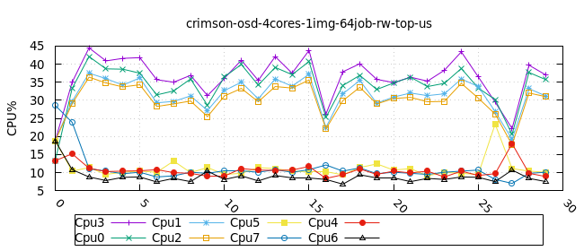
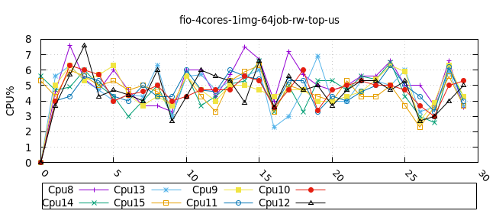
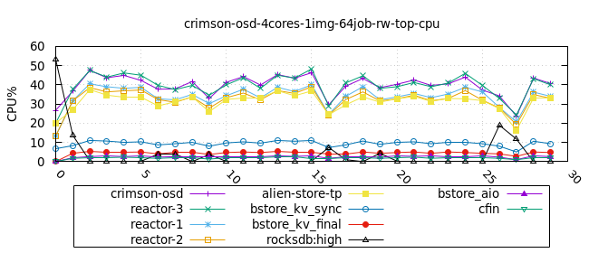
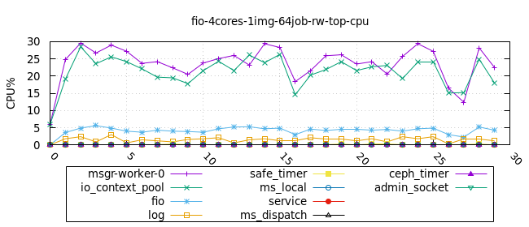
Crimson: 4 cores (CPU utilisation)

Slide 8
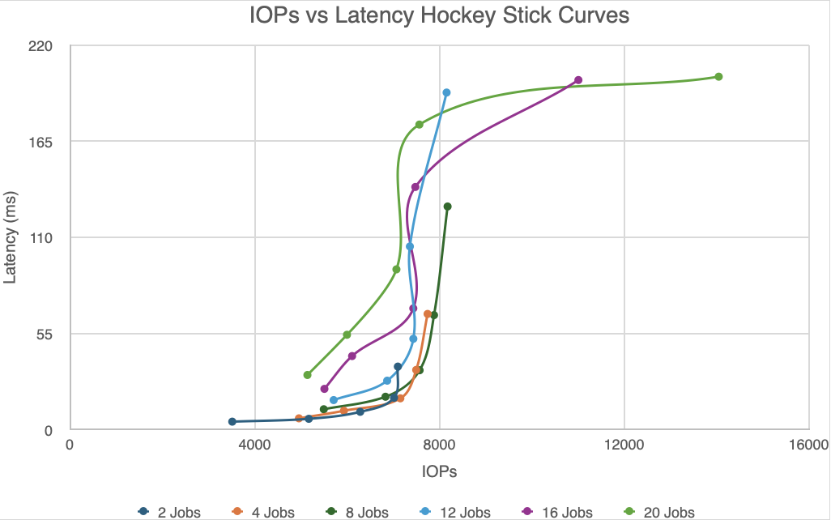
Crimson: 4 cores - Response curves
For random write 4k, the appropriate in-depth within 10 ms latency is 64, i.e. (16 iodepth, 4 jobs).
A value of (128x20) for concurrent I/O seems sufficient to reach the single SSD performance limit

Slide 9
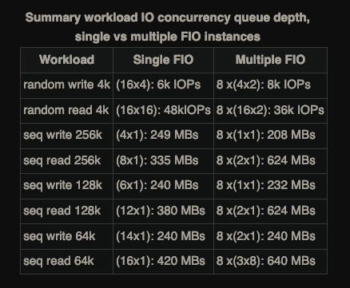
Crimson: 4 cores (Summary)

Slide 10
Outcomes
Reference FIO queue depth values for each workload, deterministic/repeatability.
Profiling data from top measurements and perf flame graphs.
PR https://github.com/ceph/cbt/pull/306 extending the Python code librbdfio.py in CBT to support this methodology.
Collaborating in the Tracker https://tracker.ceph.com/issues/66525 for Recommended deployment values.
Updates on the Crimson performance call.

