Slide 1



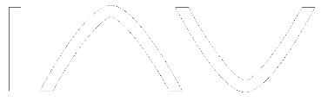




Making the right hardware choices
Darren Soothill - croit
darren.soothill@croit.io

Slide 2






Company Overview
croit – One solutions for all your storage management needs
Company Overview
KPIs
Founded in 2017, HQ in Munich, 100% management-owned
Team of 25 experts in data storage technology
High growth, profitable, and bootstrapped
Awarded as one of the fastest growing tech companies in Germany by Deloitte in 2022 & 2023
Global presence with entities in Germany and USA
70%+
revenue growth
2023
400+
customers
~4.3m€
revenue
in 2023
450 PB
petabytes managed
~20%
market growth CAGR 2024-2032
4.9 / 5
customer satisfaction rating
croit Platform & USPs
Customer & Partners
Leading on-premises software-defined storage solution built on Ceph and DAOS, simplifying complex storage orchestration
Easy-to-use, powerful, reliable, highly scalable and cost-effective management software with a low cost per terabyte
Intuitive graphical user interface for data cluster visualization and management
Flexible deployment enabling users to deploy croit on various hardware setups

Slide 3
Intro
25 years of storage pre sales
8 Years doing pre sales for Ceph
First installation of Ceph on an ARM based server
Seen many configurations over that time
  90 Server 720 OSD All Flash cluster
  50PB Cluster’s
  CephFS with Billions of files
  IO500 submissions with Ceph on Arm

Slide 4
Why this presentation?
Lots of customers get hardware choices wrong
  Poor performance
  More prone to data loss
Some hardware/ceph vendors sell bad hardware configs
Not the only way to do things but we have seen a lot of clusters

Slide 5
Data protection - Number of nodes
Number of nodes should failure domain + 1
  Replica 3 :– Minimum 4 Nodes
  EC 5+3 :– Minimum 9 nodes
When we see customers break this rule we often see data loss
  EC 4+2 on 4 nodes
  Replica 2 :- Only if you don’t care about your data

Slide 6
RocksDB/WAL on NVME
Extended recovery times if only on HDD
Any maintenance such as compaction takes an extended amount of time
Slows cluster down considerably as more writes go to HDD
Amount of objects affects amount of NVME needed
Normally a 1:12 ratio of NVME:HDD
Upstream recommendation is 1-4% typically we see 1%

Slide 7
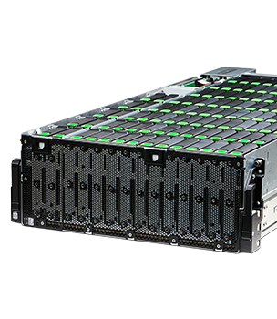
The big drive tray chassis
Typically very deep so mean rack depth can be an issue
  Around 1000mm with no cable management
Drives are replaced by top loading
  Need to pull entire tray out to replace
  failed drive
SAS Cables get stressed when replacing HDD’s causing failures
  Have customers who have moved away from these configurations due to cable problems

Slide 8
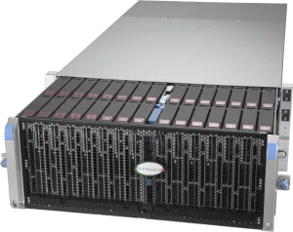
Top Loading Chassis
Limited NVME Slots
  Usually not enough for 1:12 ratio
  No extra slots for MDS/S3 meta data
Limited PCIe Slots
Have to pull whole chassis out to replace failed drive

Slide 9
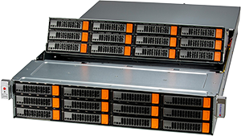
Most Common config 2U24 Drives
Typically have options for 4 or more NVME devices
Easy to service
Good mix of capacity/density
With Modern CPU’s then 1 Socket processor is best choice
  No Numa bus issues
  Lower Cost motherboard
  Don’t need lots of PCIe Lanes for HDD configs

Slide 10
Networking
For HDD
  Minimum of 2 x 25G
  Number of drives increases Network requirements
  Recovery can generate a lot of traffic
For All NVME
  Consider 2 x 100G as minimum
Dont tend to separate front end and backend networks on physical ports

Slide 11
Drive Types
SATA
M.2
SAS/SATA SSD
SAS
NVME

Slide 12
Hard Disks
Do not use SMR drives
Consider your workload
  Some drives use flash to accelerate writes
  Can sustain 1000 4K IOPS for writes
If you have a small cluster but need better performance consider Dual Actuator drives like Mach 2. Twice performance for same number of drive slots
When looking to replace hardware consider number of drives not just capacity

Slide 13
M.2 Drives
OK for OS disk
Don’t use for Mon’s if at all possible
  If using for Mon’s need to be at least 1TB with PLP
  Thermal Overload can lead to performance and durability degradation
  Only NVME drives we see wear out
    Numerous cases of people using 240/480GB drives
    Wearing out in 14-15 months

Slide 14
NVME Devices
Not all drives are created equal
Must have PLP
TLC drives and not QLC drives unless you add a TLC drive for RocksDB/WAL
Some drives exhibit VERY variable latency
  Customer had set of drives from one vendor deployed
  Deployed an extra set of drives from second vendor in same servers
  Started getting slowops and latency problems when drives started to fill up

Slide 15
Memory
8GB per OSD device
Make sure you are using all memory buses on servers equally
Always better to have too much
OSD’s can get killed when memory starts to run out
Co-located gateways will need more memory
24 Drive Chassis 256G of Ram

Slide 16
CPU Type
Intel
AMD
ARM
All good for general purpose HDD clusters
Need to be careful when doing high throughput…..

Slide 17
NVMEoF performance Verses CPU Type
NVMEoF dual gateways load balanced 1 Million IOPS
Customer tried to reproduce and only got 250K IOPS
Difference between two environments was CPU type of Gateway
Switched AMD to Intel old gen CPU and got close to our test numbers
AMD chiplet design adds latency to IO’s which slowed things down (Extra memcpy operation for IO)

Slide 18
Number of cores
Not as easy as it used to be
    CPU’s do more instructions per clock cycle
    Minimum 1 x 2GHz core per HDD OSD
    NVME’s 4 Cores per OSD
    Clusters with dedicated MDS servers then clock speed over cores

Slide 19
Gateways close to applications
We have a number of customers wanting better S3 performance
Traditional setup :-
  App S3 -> Load balancer -> Rados GW -> Ceph
    All on separate hardware
Alternative setup :-
  App S3 -> Rados GW -> Ceph
    RadosGW runs on application machine
    Reduces network latency
    Downside is RadosGW restarts need to be coordinated with client application
    Updates are now tide into client application needing to be stopped on node

Slide 20
Questions
?

Slide 21
The leading multi-purpose data storage platform for software-defined storage solutions

