Slide 1
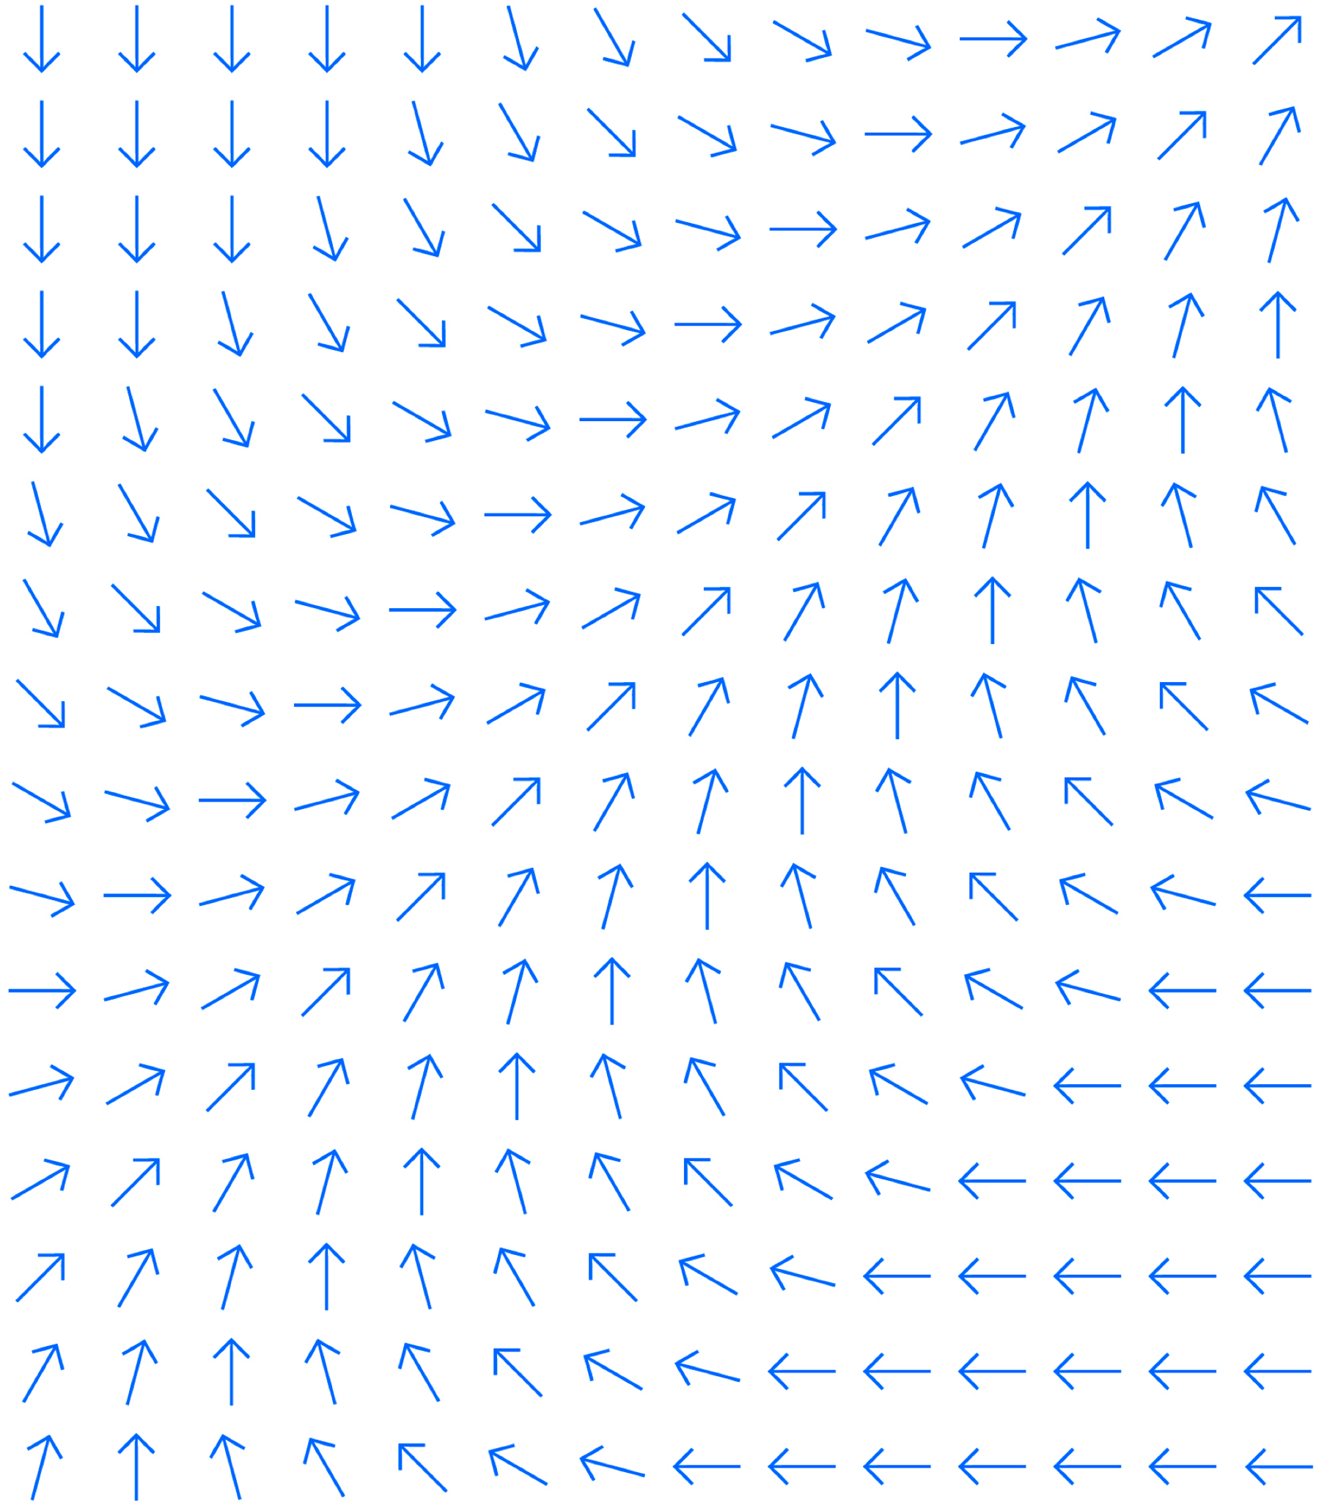
RGW Deduplication
Gabriel BenHanokh (gbenhano@ibm.com)

Slide 2
Follow Server-Side Copy model
Server-Side-Copy supports sharing tail objects between multiple head objects which is a form of deduplication
The S3 object identity (name, attributes...) is maintained in the Head-Object and must be unique
The Tail objects holds plain data and can be shared
The first 4MB in the Head Object is duplicated
Is it possible to split the head object into two separate objects?
  The first object holding only the attributes (and the name)
  The second object will be a new tail object holding only data?
This could be utilized in **future** release as an enhancement
Ceph Storage

Slide 3
Existing Server-Side Copy - Limitations
Doesn’t support encrypted objects
Doesn’t support Copy between 2 remote objects
Doesn’t support Copy between 2 different pools
Doesn’t support Copy with different placement rules
  Why can’t we simply override the TGT placement rules?
Ceph Storage

Slide 4
Changes to Server-Side Copy Model
Server-Side-Copy
  Read SRC Head Object (data and attributes)
  INC Ref-Count on SRC Tail-Object
  Copy the Head Object data and attributes from SRC to the TGT
    Replace the TGT Manifest with a modified SRC Manifest
  BG-Delete of old TGT if existed
RGW Dedup
  Keep the existing TGT Head-Object (data and attributes)
  Read SRC Head Object attributes only(no data)
  INC Ref-Count on SRC Tail-Object
  Copy SRC Manifest to TGT
  BG-Delete TGT Tail-Objects
Ceph Storage

Slide 5
Changes to Server-Side Copy Model (Cont)
Do we have a mode for BG Delete of Tail Objects while keeping the Head-Object intact?
Do we support a BG-Delete of tail objects while the object is still active?
  Need to protect against access to the tail objects while they are being deleted
  Do we know if any rgw holds an old copy of the manifest?
Ceph Storage

Slide 6
Step-0: Preparation (Ingress)
Iterate over all buckets and over all objects in the buckets
  Skip objects not in your shard (we got N shards)
  Skip objects smaller than 4MB (since we keep the head-obj)
For each S3-Object find its head-object and read attributes from it into a record
  MD5
  SHA256 (if exists)
  Object-length
  Part-count (for multi-part)
  version
  Manifest
  Shared-Manifest-Object or Dedicated-Manifest-Object
  The head-object Rados-name (which we already have)
    No need for head-object name if this is a Shared-Manifest-Object
Ceph Storage

Slide 7
Step-0: Preparation (Egress)
Shard the output into M shards
The output is broken into Blocks of fixed size (4-16KB??)
  Blocks are uniquely identified within an output shard by a 32 bits disk-block-index
  The output shard is a concatenation of the outputs of the N Ingress shards
Each Block contains multiple Records
  Records don't cross block boundaries
  When reading a Record, we need to read its full disk-block and search for it
    Ideally, we will use 4KB disk-blocks
Write the Disk Blocks into Rados/RGW objects
  Try and fit multiple sequential blocks in a single write for efficiency
  Ideal write size is 4MB
Ceph Storage

Slide 8
Step-1: Table Construction
Process a single owned (concatenated) output shard
Read the summery table to find the entries count and pre-allocate an open-addressing hash-table
Hash-table entries format:
  Key: 16B MD5 + 4B Length + 2B Part_Count
  Data: 4B disk-block-index + 1B flags +1B pad
    Flags:
      Shared-Manifest-Object or Dedicated-Manifest-Object
      Singleton or Multicopy entry
      Has valid SHA256 or need to be calculated
  Hash-Links: 4B indices into the table instead of pointers (allows 4B unique MD5)
  Total is 32B per a unique MD5
Ceph Storage

Slide 9
Step-1: Table Construction (Cont.)
Process the records one by one based on the MD5
Lookup the MD5 in the table and if doesn’t exist add a new entry
  The key is the MD5 # Size # Part-Count
  Set the current Block-Index as value
  Set flags:
    Shared-Manifest-Object or Dedicated-Manifest-Object based on the record values
    Singleton (as it is the first time we saw it)
    Has valid SHA256 or need to be calculated based on the record values
Ceph Storage

Slide 10
Step-1: Table Construction (Cont.)
If a hash-table entry already exists for the record’s MD5:
  If the hash-table entry is a Shared-Manifest-Object:
    If the new record is a Shared-Manifest-Object -> skip it
    If the new record is a Dedicated-Manifest-Object -> turn off the hashtable-entry singleton bit
  If the hash-table entry is a Dedicated-Manifest-Object:
    If the new record is Shared-Manifest-Object -> change the hashtable-entry setting the new record index in the entry and updating the SHA256 bit based on the new record values (should probably be set)
      Change the entry flag from Dedicated-Manifest-Object to Shared-Manifest-Object
      Turn off the singleton bit if it is on (as we will dedup the entry)
    If the new record is a Dedicated-Manifest-Object:
      Turn off the singleton bit if it is on (as we will dedup the entry)
We will always use a Shared-Manifest-Object as SRC (if exists)
Ceph Storage

Slide 11
Step-2: Deduplication
Purge all entries not marked for-dedup (i.e. singleton bit is set)
  Ideally destroy the old table and construct a new compact table holding only entries we need to dedup with a single entry per a unique MD5
Iterate over all disk-records in the shard
  If the record is marked as Shared-Manifest-Object -> skip it (no need to dedup)
    Assert that the SRC-entry in the table is marked as a dedup entry
  Lookup the record MD5 in the hashtable:
    if doesn’t exist -> skip it (it is a singleton and it was purged)
    If the record block-index matches the hashtable entry -> skip it (it is the SRC object)
    All other entries are Dedicated-Manifest-Objects with a valid SRC object
  There is an optional SHA256 calculation step which I'm skipping here for the sake of brevity...
Ceph Storage

Slide 12
Step-2: Deduplication (Iteration Cont.)
Use the entry Disk-Block-Index to read the SRC record from disk
  Direct read of a single disk block (SSD will help here)
  Search for the record in the block looking for its MD5
Increment the ref-count for all the tail-objects based on the manifest stored in the SRC-Object disk-record
  If any of the tail objects changed since we created the disk-record abort and rollback any ref-count incrementation we did
    Can we trust the names in the manifest to uniquely identify tail objects?
Atomically update the TGT head-object:
  Verify the MD5/SHA256/version are the same
    If not abort the operation and rollback the ref-inc on the SRC tail objects
  Overwrite the manifest in the TGT head-object with the one from the SRC-Disk-Record
  If all went fine -> send the previous manifest of the TGT for BG-delete
Ceph Storage

Slide 13
Step-2: Deduplication (Iteration Cont.)
If the SRC Record was marked as Dedicated-Manifest-Object add a Shared-Manifest-Object attribute to its head-object with 8 Bytes hash of the manifest
  The manifest hash will allow scrubber to sanity check dedup
The Shared-Manifest-Object attribute will be used to identify the Object as being a part of a dedup
It will prevent us from attempting to dedup it again
We will always choose a Shared-Manifest-Object as SRC for dedup to make sure all duplications share the same tail objects
Ceph Storage

Slide 14
Division of Labor
Divide the work between all available rgw members
Use double sharding
  Ingress sharding by S3 object-name (N)
  Egress sharding by MD5 hash (M)
Work will be done from a periodical BG Task
The work is incremental with each cycle improving upon the previous cycles
Loosing rgw members will only affect their assigned work (we will keep duplicated data longer) and won't affect currentness
  No need for a recovery model in case a rgw member disconnects
Ceph Storage

Slide 15
Division of Labor - Ingress
Ingress sharding divides the object-names space between rgw members so attributes for a given S3-Object will be read once
Ideal Ingress sharding should match the rgw members count
  Could be done by querying the MNG or running a quick sync step between rgw members
  Balanced and efficient, but goes against the rgw independency model
  Vulnerable to members disconnects
Simple Ingress sharding will use high shard-count (128/256...) and rgw members will grab one shard after another
  Robust model, but can be unbalance unless the units are small enough
  Requires rgw to perform multiple bucket listing (once per-shard)
    List by shard to see only your shard objects!
Ceph Storage

Slide 16
Division of Labor - Egress
Egress sharding produce standalone MD5 units which can be process independently
  All instances of a given MD5 will go to the same shard
  This allows identifying all duplicates of a given S3-Object using only information from a single shard
Each unit should have similar count of unique MD5 hashed
  A simple division works due to uniform distribution of MD5 hashes
Each unique MD5 will be mapped to a single table entry
  Entry size is about 32 Bytes
  All entries should fit in memory of a single rgw member
  16M entries will consume about 1GB or RAM
Ceph Storage

Slide 17
Questions
For detailed design:
https://docs.google.com/document/d/152VyCTR2NlZ6ongbe6-CJfP4qxr1_zH83FB_WukWD7c/edit
Ceph Storage

